Slide 1
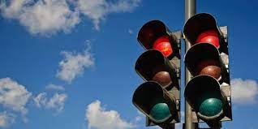
Traffic Light Signal Control using Deep Reinforcement Learning
Presented by-
Sayantika Mandal (1810110224)
Sanskar Tewatia (1810110215)
Under supervision of
Dr. Madan Gopal
(Professor, Electrical Department)

Slide 2
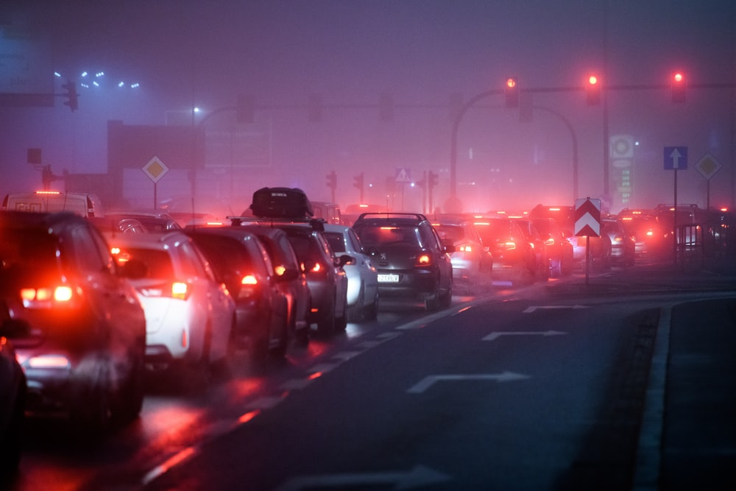
INTRODUCTION
Increasing population.
More people able to afford personal cars.
At present, traffic signals are controlled by -
setting a fixed duration for each state of the traffic light,
using vehicle-activated inductive sensors under the road to estimate the signal duration.
Both methods - simple to implement, but unable to adapt to emergency, accidental or rush hour scenarios.
An adaptive traffic signal control(ATSC) technique would -
accurately process the current state of traffic
take optimal actions in regard to that state,
help decrease waiting time and queue length.
Notes:
In such tricky cases, usually traffic policemen have to step in, and manually control the flow of traffic, based on expertise.

Slide 3
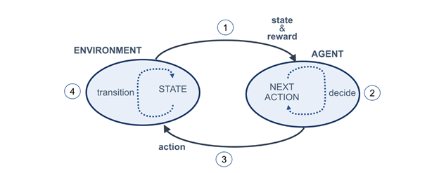
INTRODUCTION
DEEP REINFORCEMENT LEARNING(DRL):
Most widely used technique to research about optimisation of traffic signals.
4 main components - ENVIRONMENT, STATE, ACTION, REWARD.
Fig. 1: Reinforcement learning cycle
The agent uses DRL algorithms(eg. Deep Q Network) to estimate reward.
DRL utilises the power of Deep Neural Networks(DNN) where the agent learns how to solve it by using exploration & exploitation (Trial & Error).
After perceiving the current state of the traffic simulator, it chooses the optimal action (traffic light color) based on the exploitation of its learning experience, and the goal is to maximize the reward.
Notes:
Reinforcement Learning (RL), a feedback-based Machine Learning technique in which an agent observes a stochastic environment, perceives its state and learns automatically by exploring the environment and performing actions on a timely basis which results in a change in the environment to another state
ENV – It is the representation of the problem
Agent – Is a computer program whose purpose is to take action on the decision
State – As the name suggests, it is the current state of the variables in the problem, like how many cars on which roads
Action – it is the decision taken by the agent
Reward – it is the feedback which is provided by the environment in regard to the action taken by the agent
The learning agent overtime learns to maximize these rewards so as to behave optimally at any given state it is in.

Slide 4
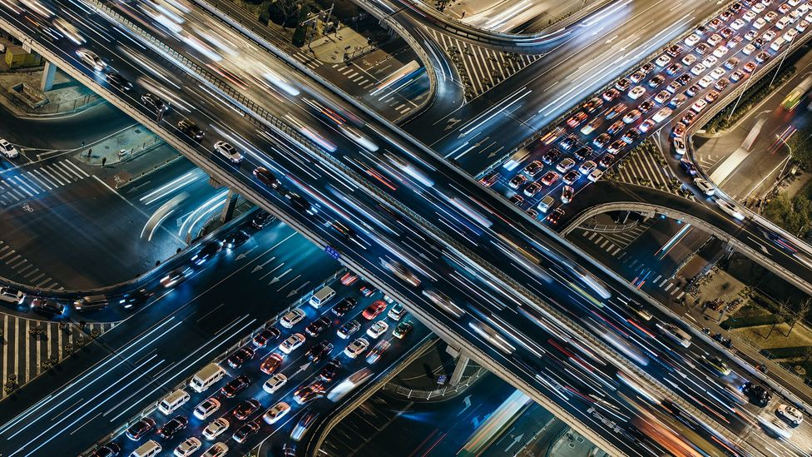
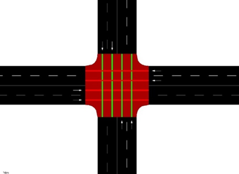
WORK DONE
Simulation of Urban MObility (SUMO) - Free and open-source traffic simulation software used for road network map creation and traffic light control can be interfaced through an application programming interface (API) from python - TraCI in our case.
Single 4 way junction.
2 types of traffic – East-West or North-South traffic.
Each road has 2 lanes of length 750m.
1250 cars per episode of training.
The duration of green signal = 8s, and yellow = 3s.
Fig. 2 : The SUMO environment junction representing 2 types of traffic

Slide 5
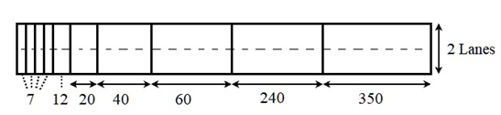
DRL APPROACH DESCRIPTION
STATE REPRESENTATION:
Spatial information of the vehicles inside the environment.
Each arm of the intersection - discretized into 10 cells.
Cells not of same size:
the cell length increases as its distance from the intersection increases.
decreases the computational complexity.
Total 40 cells in the entire intersection ⇒ number of states is 40.
Hence, 1x40 binary state matrix formed.
Fig. 3 : State representation design of the east arm of the intersection

Slide 6
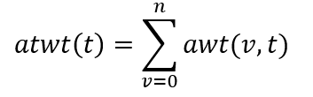

DRL APPROACH DESCRIPTION
ACTION SET:
A={NSG,EWG}
NSG: North-South Green; green traffic phase of 8s active for vehicles in the north-south intersection arm which want to go straight
EWG: East-West Green; green traffic phase active for vehicles in the east-west intersection arm which want to go straight
If two different actions chosen at consecutive action steps ⇒ a 3s yellow phase is introduced in between.
REWARD FUNCTION:
Accumulated total waiting time(atwt) used as the metric.
where:

Slide 7
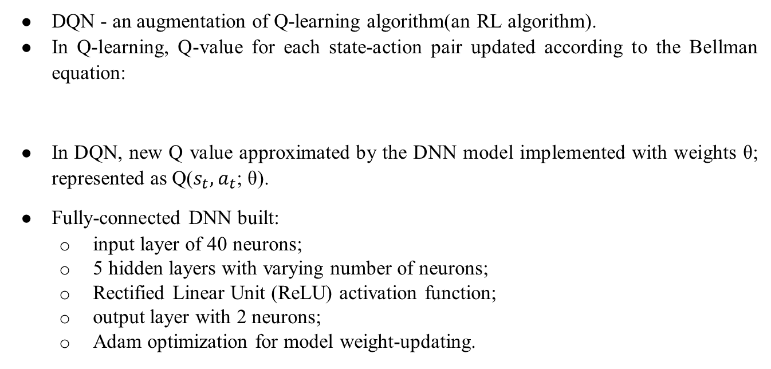
DEEP Q-NETWORKS
DQN - an augmentation of Q-learning algorithm(an RL algorithm).
In Q-learning, Q-value for each state-action pair updated according to the Bellman equation:
In DQN, new Q value approximated by the DNN model implemented with weights θ; represented as Q($s_{t},a_{t}$; θ).
Fully-connected DNN built:
input layer of 40 neurons;
5 hidden layers with varying number of neurons;
Rectified Linear Unit (ReLU) activation function;
output layer with 2 neurons;
Adam optimization for model weight-updating.

Slide 8
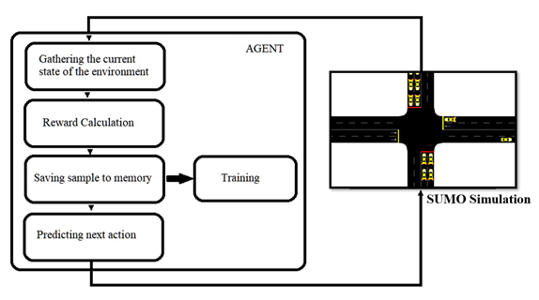
TRAINING PROCESS
Training done across 150 episodes(2 hours each).
1 simulation step = 1 second in SUMO ⇒ 7200 steps per episode.
Experience Replay technique adopted to improve the learning efficiency and performance of the agent.
To balance Exploration vs. Exploitation trade-off, ɛ-greedy exploration policy employed for action-selection.
Algorithm explores with a probability ɛ.
Agent exploits its learning experience with a probability 1- ɛ.
Fig. 4 : Agent’s workflow

Slide 9
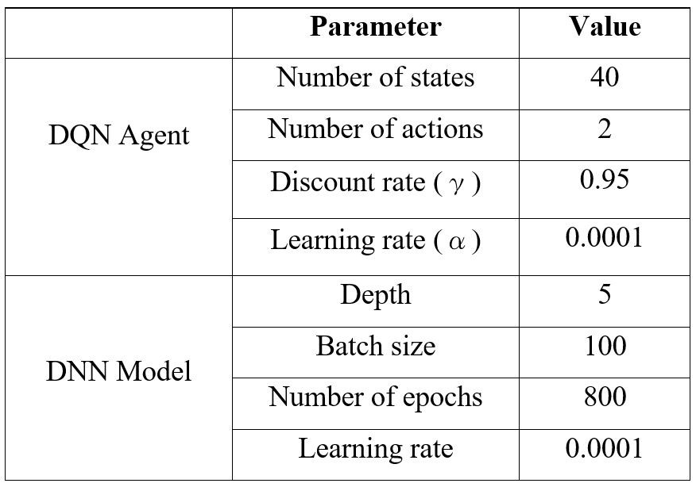
DQN & DNN HYPER-PARAMETERS
Table 1: DQN Agent and DNN model hyper-parameter details

Slide 10
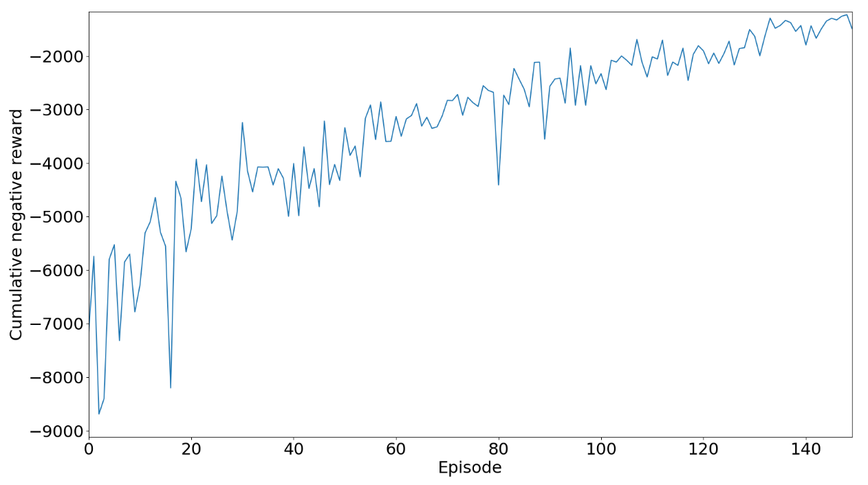
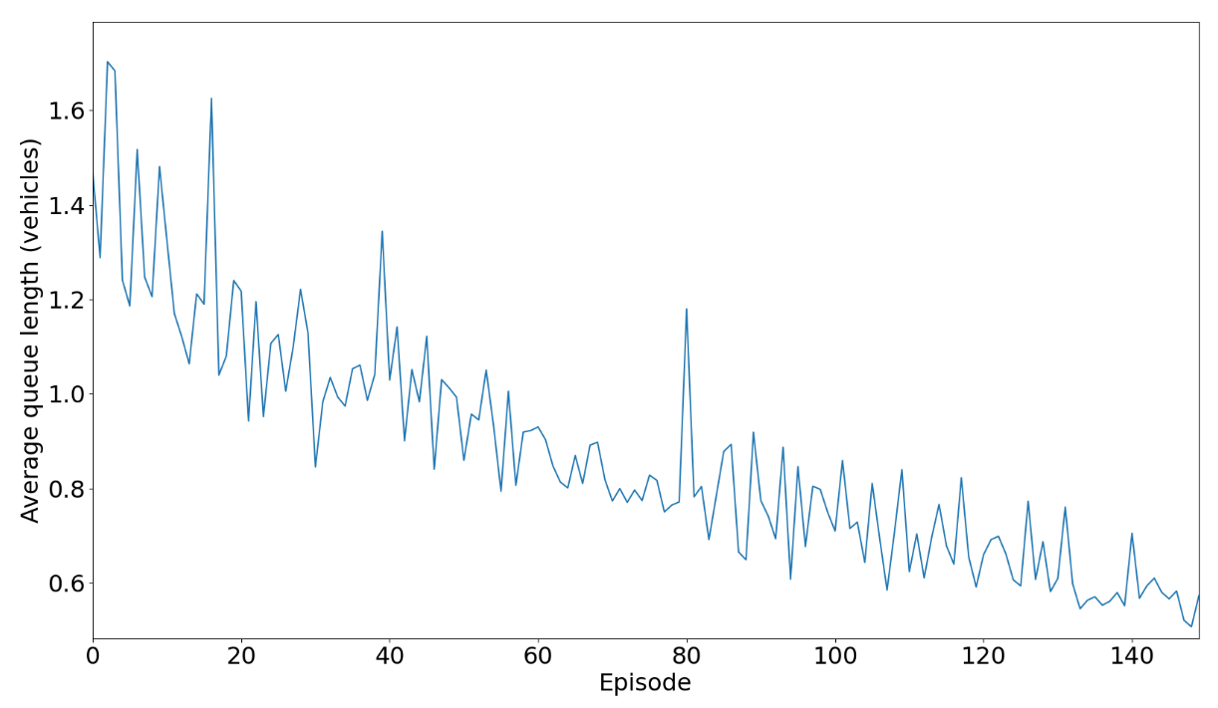
TRAINING PERFORMANCE
Fig. 6: Average queue length of vehicles per episode during training
Fig. 5: Cumulative negative reward per episode during training

Slide 11
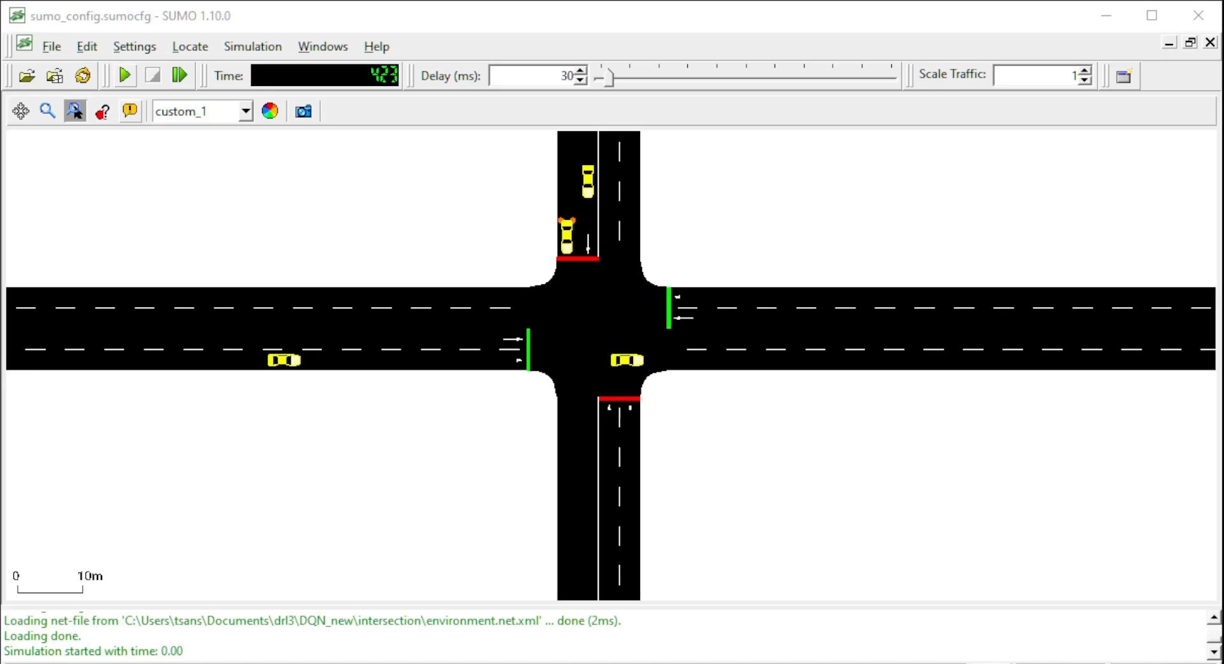
PRE-TIMED TRAFFIC SIGNAL CONTROL SIMULATION

Slide 12
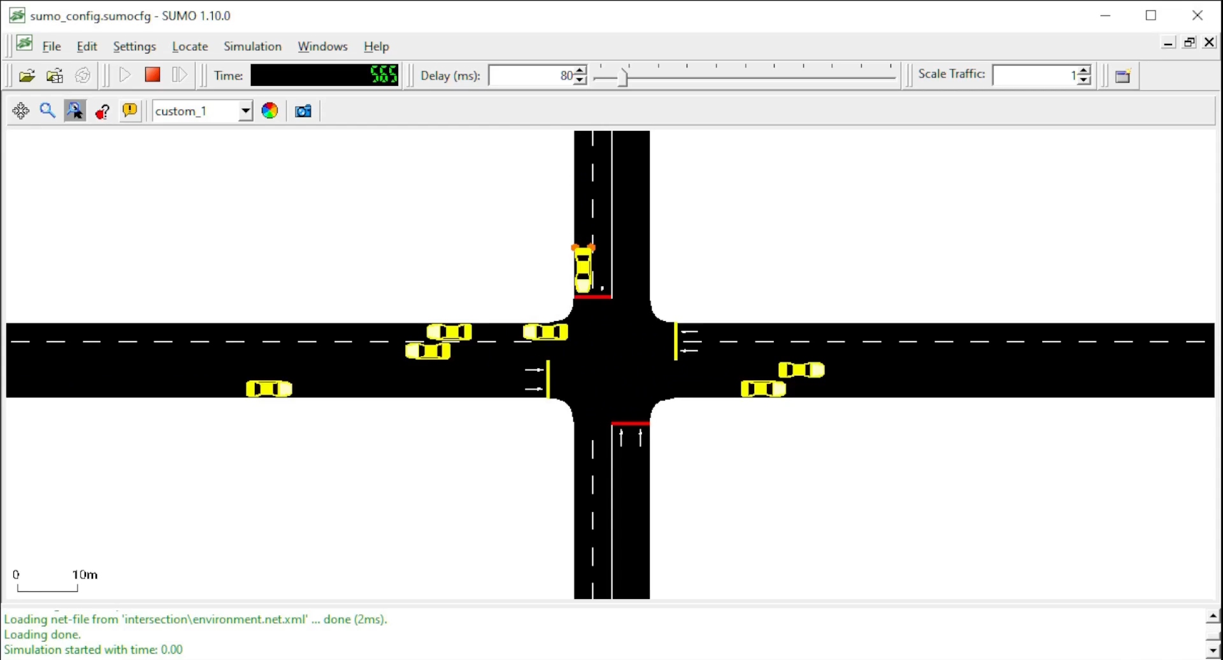
DRL AGENT BASED ATSC - TESTING SIMULATION

Slide 13
REFERENCES
H. Wei et al, “IntelliLight: A Reinforcement Learning Approach for Intelligent Traffic Light Control,” Proceedings of the 24th ACM SIGKDD International Conference on Knowledge Discovery & Data Mining, pp. 2496–2505, July 2018.
Alan J Miller., “Settings for fixed-cycle traffic signals.”, Journal of the Operational Research Society 14, vol. 4, pp. 373–386, 1963.
Lior Kuyer, Shimon Whiteson, Bram Bakker, and Nikos Vlassis, “Multiagent reinforcement learning for urban traffic control using coordination graphs,” Machine learning and knowledge discovery in databases, pp. 656–671, 2008.
Wiering, M., “Multi-agent reinforcement learning for traffic light control,” In Machine Learning: Proceedings of the Seventeenth International Conference (ICML’2000), pp. 1151–1158, 2000.
Sajad Mousavi, S., Schukat, M. and Howley, E., “Traffic Light Control Using Deep Policy-Gradient and Value-Function Based Reinforcement Learning,” arXiv e-prints, pp. arXiv-1704, 2017.
Martin et al., “Application of Deep Reinforcement Learning in Traffic Signal Control: An Overview and Impact of Open Traffic Data”, Journal of Applied Sciences, vol. 10, issue 4011, 2020.
Liang, X., Du, X., Wang, G. and Han, Z., “Deep reinforcement learning for traffic light control in vehicular networks,” arXiv preprint, arXiv:1803.11115, 2018.
Williams, R. J., “Simple statistical gradient following algorithms for connectionist reinforcement learning”. Machine learning, vol. 8, issue 3-4, pp. 229–256, 1992.
Chin, Y.K.; Kow, W.Y.; Khong, W.L.; Tan, M.K.; Teo, K.T.K., “Q-Learning Traffic Signal Optimization within Multiple Intersections Traffic Network,” In Proceedings of the 2012 Sixth UKSim/AMSS European Symposium on Computer Modeling and Simulation, Valetta, Malta, pp. 343–348, November 2012.
Li, D., Wu, J., Xu, M., Wang, Z., Hu, K., “Adaptive Traffic Signal Control Model on Intersections Based on Deep Reinforcement Learning,” J. Adv. Transp. 2020.
K. Tan et al, “Deep Reinforcement Learning for Adaptive Traffic Signal Control,” Proceedings of the ASME 2019, Dynamic Systems and Control Conference DSCC2019, November 2019.
A. Vidali, L. Crociani, G. Vizzari, and S. Bandini, “A deep reinforcement learning approach to adaptive traffic lights management,” in Proc. Workshop ‘From Objects Agents’, pp. 42–50, 2019.
L. Li, Y. Lv, and F.-Y. Wang, “Traffic signal timing via deep reinforcement learning,” IEEE/CAA Journal of Automatica Sinica, vol. 3, issue 3, pp. 247–254, 2016.
W. Genders and S. Razavi, “Using a deep reinforcement learning agent for traffic signal control,” arXiv preprint arXiv:1611.01142, 2016.
Mengqi Liu, Jiachuan Deng, Ming Xu, Xianbo Zhang, and Wei Wang, “Cooperative Deep Reinforcement Learning for Traffic Signal Control.”, 2017.
Gao, J., Shen, Y., Liu, J., Ito, M., and Shiratori, N., “Adaptive traffic signal control: Deep reinforcement learn learning algorithm with experience replay and target network,”. arXiv preprint arXiv:1705.02755, 2017.

